Slide 1

Pharmaceutical Sales Analysis
Victoria Tamburro

Slide 2
Data Collection
Collected and groomed by researcher Milan Zdravković.
The initial dataset was created from transactional sales data collected from a single pharmacy’s point-of-sales system.
The 57 drugs sold were then grouped to the Anatomical Therapeutic Chemical (ATC) Classification System Categories.
M01AB - Anti-inflammatory and antirheumatic products, non-steroids, Acetic acid derivatives and related substances
M01AE - Anti-inflammatory and antirheumatic products, non-steroids, Propionic acid derivatives
N02BA - Other analgesics and antipyretics, Salicylic acid and derivatives
N02BE/B - Other analgesics and antipyretics, Pyrazolones and Anilides
N05B - Psycholeptics drugs, Anxiolytic drugs
N05C - Psycholeptics drugs, Hypnotics and sedatives drugs
R03 - Drugs for obstructive airway diseases
R06 - Antihistamines for systemic use
The data was collected for six years, with an incomplete final year.

Slide 3

Contents
Introduction
Statistical Analysis
Time Series Trends
Long Term Trends
Linear Regression Modeling
Forecasting and Re-Ordering
Conclusion

Slide 4
Introduction
Through this analysis data trends will be discovered and forecasting models will be created to predict long term generalized trends for specific drug groups.
These machine learning forecasting models and seasonality trends can be used to inform strategic re-ordering.
Recommendations will be made for further analysis based on exogeneous variables.

Slide 5
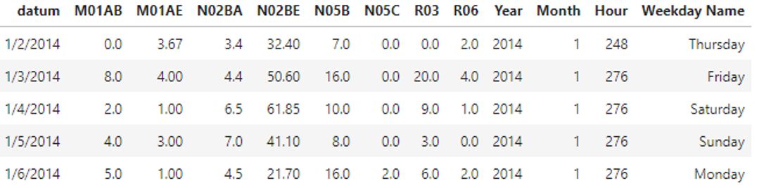
Understanding the Data
The data is presented in several views which include hourly, daily, weekly, and monthly point-in-time sales.
For the purposes of this analysis, we assume that the values presented represent the number prescriptions filled.
Example Data Set:

Slide 6
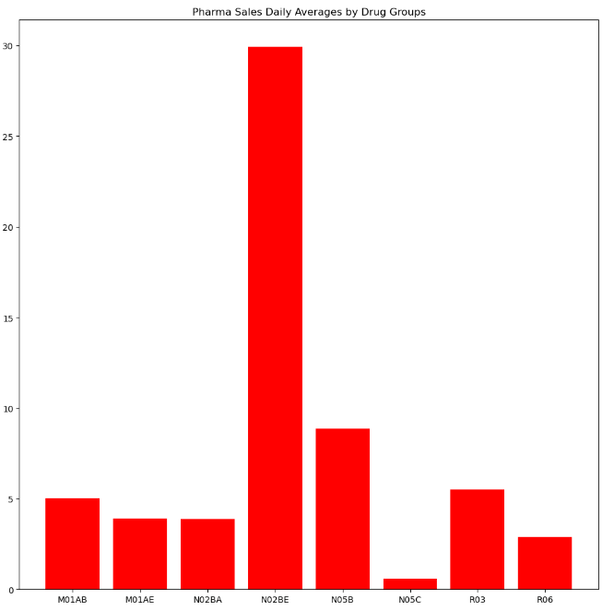
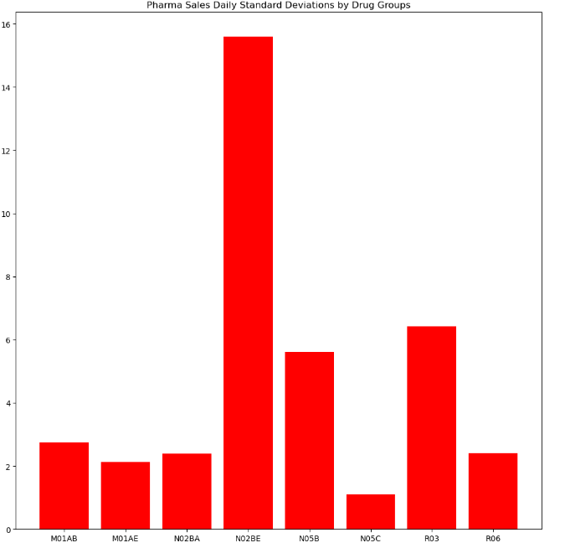
Descriptive Statistics Highlights
Upon inspection of the descriptive statistics it can be noted that the daily, weekly, and monthly collected data increases proportionately for the mean, median, standard deviation.
It as also evident that the drug group N02BE is the most sold drug, and the drug group N05C is the least sold drug.
There is also a high level of variance for the drug group N02BE, alluding to its seasonal influence which will be covered in later slides.

Slide 7
Descriptive Statistics
 | M01AB | M01AE | N02BA | N02BE | N05B | N05C | R03 | R06
count | 2106 | 2106 | 2106 | 2106 | 2106 | 2106 | 2106 | 2106
mean | 5.033683 | 3.89583 | 3.880441 | 29.917095 | 8.853627 | 0.593522 | 5.512262 | 2.900198
std | 2.737579 | 2.133337 | 2.38401 | 15.590966 | 5.605605 | 1.092988 | 6.428736 | 2.415816
min | 0 | 0 | 0 | 0 | 0 | 0 | 0 | 0
25% | 3 | 2.34 | 2 | 19 | 5 | 0 | 1 | 1
50% | 4.99 | 3.67 | 3.5 | 26.9 | 8 | 0 | 4 | 2
75% | 6.67 | 5.138 | 5.2 | 38.3 | 12 | 1 | 8 | 4
max | 17.34 | 14.463 | 16 | 161 | 54.833333 | 9 | 45 | 15
M01AB | M01AE | N02BA | N02BE | N05B | N05C | R03 | R06
302 | 302 | 302 | 302 | 302 | 302 | 302 | 302
35.102441 | 27.167611 | 27.060295 | 208.627161 | 208.627161 | 4.138935 | 38.439811 | 20.224561
8.617106 | 7.043491 | 8.086458 | 76.069221 | 76.069221 | 3.129265 | 22.900873 | 11.381464
7.67 | 6.237 | 3.5 | 86.25 | 86.25 | 0 | 2 | 1
29.3875 | 22.3875 | 21.3 | 149.3 | 149.3 | 2 | 21 | 11.475
34.565 | 26.7895 | 26.5 | 198.3 | 198.3 | 3.979167 | 35 | 17.5
40.175 | 31.0465 | 32.475 | 252.4715 | 252.4715 | 6 | 51 | 26
65.33 | 53.571 | 60.125 | 546.899 | 546.899 | 17 | 131 | 65
count | 70 | 70 | 70 | 70 | 70 | 70 | 70 | 70
mean | 149.992 | 116.514286 | 115.020843 | 892.542071 | 262.118571 | 17.842857 | 167.675 | 86.662571
std | 31.485325 | 27.889336 | 31.245899 | 338.843908 | 85.06093 | 8.481242 | 81.767979 | 45.859336
min | 0 | 0 | 0 | 0 | 1 | 0 | 0 | 0
25% | 137.49 | 103.51825 | 94.375 | 648.1875 | 223.75 | 12 | 112 | 49.875
50% | 154.635 | 114.84 | 117.225 | 865.8245 | 250.3 | 18 | 160 | 74.1
75% | 169 | 128.35975 | 133.8375 | 1061.58 | 293.65 | 23 | 218.25 | 119.8075
max | 211.13 | 222.351 | 191.6 | 1856.815 | 492 | 50 | 386 | 213.04

Slide 8
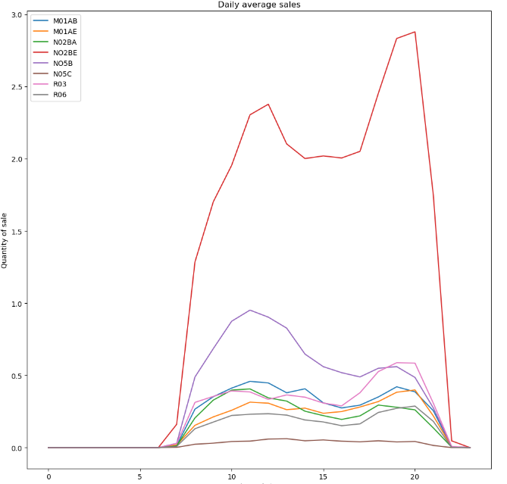
Time of Day
The data was aggregated by average sales by time of day. Upon visualization it can be observed that on average the flux of drugs sold at various times of the day seems to differ based on these groups.
Notably, N02BE has two peaks at 12:00PM, and 9:00PM with a steep drop in purchase frequency, while R03 has only an evening peak which has a more fluent onset.
This could be perhaps due to the nature of the drug and the availability of the patients that are able to visit the store during those hours. The times seem to trend with a lunch time and evening time store visit.
Given further customer demographic information and customer analysis, this could impact certain aspects of the business such as store staffing and shipment/loading scheduling.

Slide 9
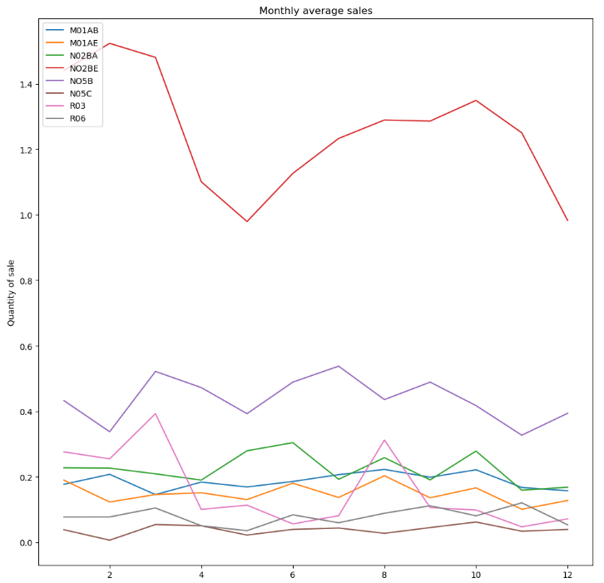
Time of Month
Additionally, the data was aggregated by average sales by time of month. Several trends can be seen.
N02BE has a sharp spike in February and a smaller spike in October. This is an interesting trend as these drugs are generally painkillers, which one wouldn’t assume to have any type of seasonality, such as R06 which is an antihistamine for seasonal allergies.
Seasonal trends can be observed for R06 aligning with Spring, Summer and Fall allergy seasons.
With further data collection on patient diagnoses it may be worth investigating further into the reason for N02BE trending as it is the highest selling drug of the pharmacy.

Slide 10
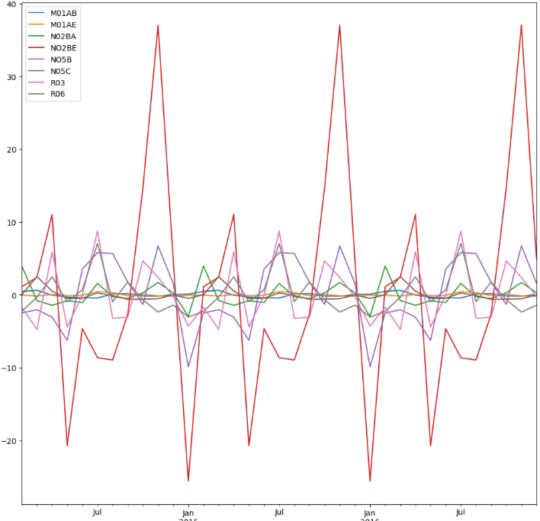
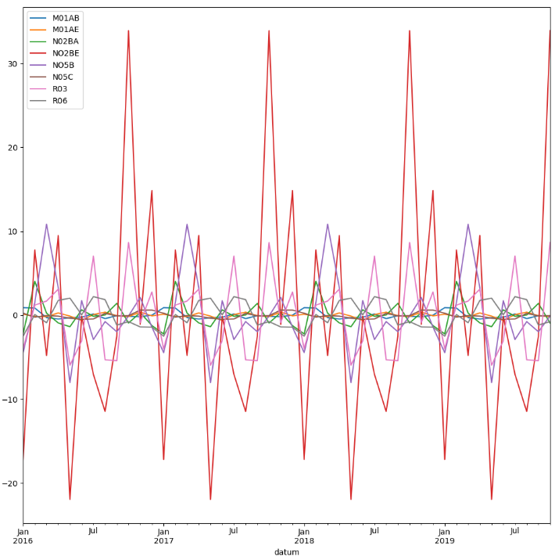
Seasonality
The data was split into three-year intervals for clarity of visualization. The data was then decomposed by drug group using an additive model, to indicate the impact of the seasonality.
It can be observed that the impact of the seasons in the time series dataset is the greatest on NO2BE

Slide 11
Seasonality Detailed

Slide 12
Observing Long-Term Trends
Because of the volatile sales volume changes due to seasonality, it was required to normalize the data with moving averages to get a scope of the long-term drug sale trends.
The following visualizations were created from 30, 120, and 365 day intervallic moving averages. A linear regression model was performed on the 365-day normalized averages, and three of the drugs displayed clear linear tendencies over the six years: R03, R06, and N02BA.
These trends can be indicative of effectiveness, comfort of prescription from medical providers, advertising, and potential endemic/pandemic tendencies.

Slide 13
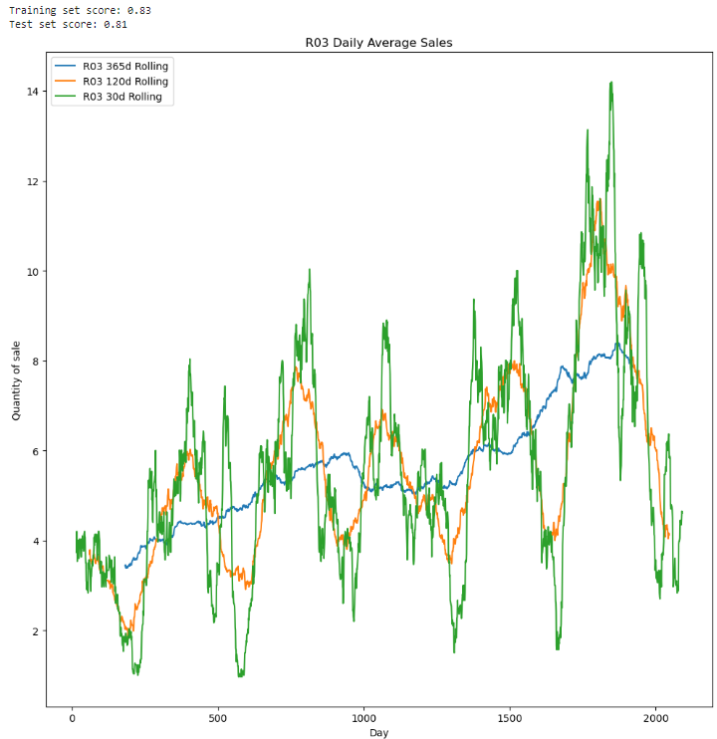
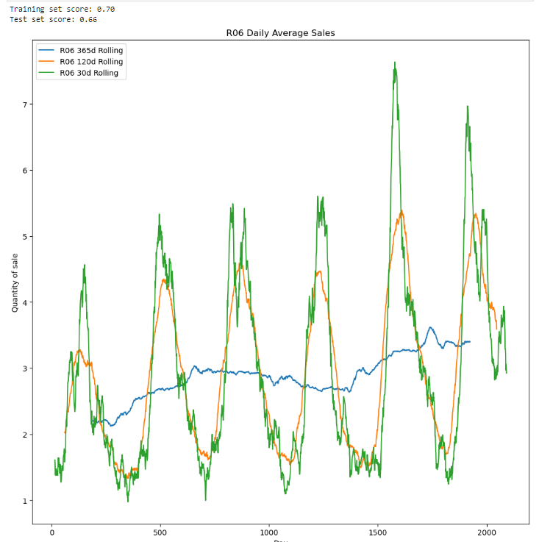
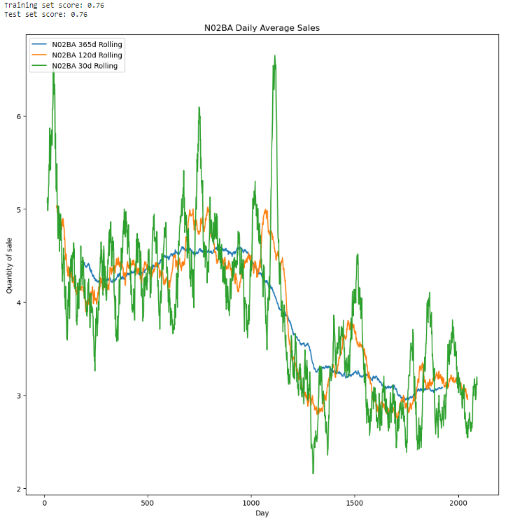

Slide 14

Linear Regressions
N02BA Predictive Model - Reducing over Time
76% Accuracy Training Score
76% Accuracy Test Score
R03 Predictive Model – Increasing Significantly
83% Accuracy Training Score
81% Accuracy Test Score
R06 Predictive Model – Increasing Slightly
70% Accuracy Training Score
66% Accuracy Test Score

Slide 15
Conclusion
The forecasting models can be used to predict long term generalized trends for specific drug groups. These forecasting models and seasonality trends can inform strategic re-ordering of these drugs.
It should be noted that while these predictions show the trends of sales, there are other factors that should also play a part in the re-ordering of a drug.
Pharma Capacities - Shelf/Stocking space availability
Price Optimizations
Essential Rescue drugs that must be kept on hand such as R03 which is used for obstructive airway diseases

Slide 16
References
Pharma sales data. (n.d.). Www.kaggle.com. Retrieved December 18, 2022, from https://www.kaggle.com/datasets/milanzdravkovic/pharma-sales-data
‌statsmodels.tsa.seasonal.seasonal_decompose — statsmodels. (n.d.). Www.statsmodels.org. https://www.statsmodels.org/dev/generated/statsmodels.tsa.seasonal.seasonal_decompose.html
sklearn.linear_model.LogisticRegression — scikit-learn 0.21.2 documentation. (2014). Scikit-Learn.org. https://scikit-learn.org/stable/modules/generated/sklearn.linear_model.LogisticRegression.html

